Slide 1
Dr. Peter Cheng

Slide 2
Past Experience
~ 1987. Management Trainee
~ 1997. Apparel Production
~ 2000. JV Kenya
~ 2007. Withdrawal
~2018. Ministry of Crab.

Slide 3
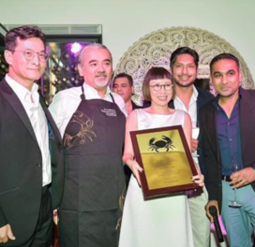
Ministry of Crab- Shanghai
No softdrink
Healthy lifestyle (core value)

Slide 4
Business Scope

Slide 5
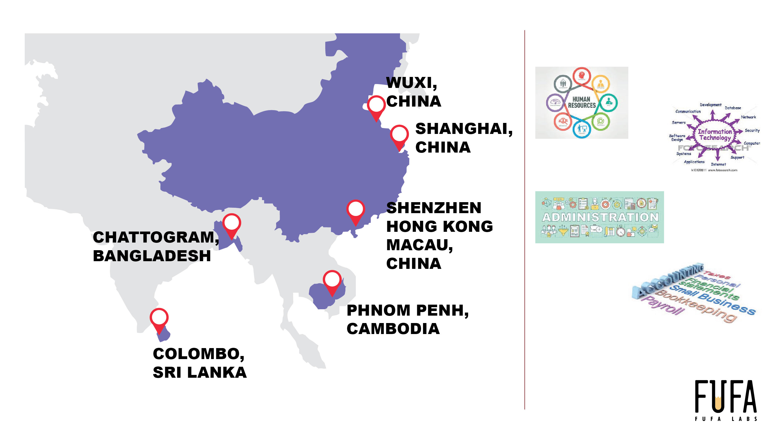
WUXI,
CHINA
SHANGHAI,
CHINA
SHENZHEN
HONG KONG
MACAU,
CHINA
CHITTAGONG,
BANGLADESH
PHNOM PENH,
CAMBODIA
COLOMBO,
SRI LANKA

Slide 6
Local Partner and My Insight
Colombo- unreasonably expensive
Free education (high literacy level)
Registration process (Not transparent)
Foreign exchange control
Ownership
Lots of bare & abandoned agricultural lands

Slide 7
Nuke Café (Cambodia)

Slide 8
Nail Bar

Slide 9
Demeter + Salasusu

Slide 10
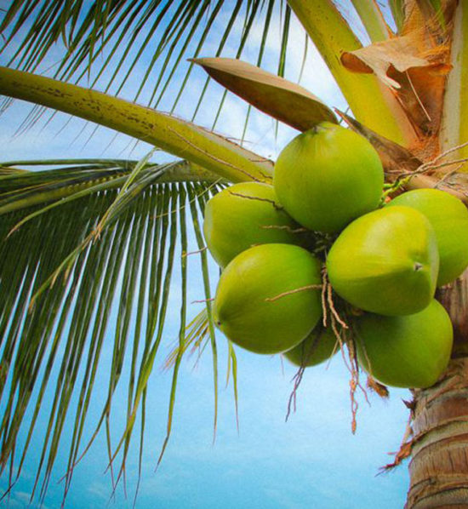
Case Study- Coconut Farm
Agriculture sector (5 years income tax exemption)
Tax (14% Corporate Income Tax+ 14% Dividend Tax)
100% Land Tax for foreigners.
- Foreign investors are permitted to acquire land on lease-hold basis (99 years) when the foreign shareholding is less than 50%.
- 3% stamp duty on first LRK 100,000. 4% thereafter.
- Lawyer charge: 2-3%
Capital Investments shall be made through an “Inward Investment Account (IIA)
Budget Analysis 2021 (assets.kpmg)
Sri Lanka - Corporate - Taxes on corporate income (pwc.com)
Investment Policy – Investment Opportunities – Board of Investment of Sri Lanka (investsrilanka.com)
Sri Lanka Guide: Additional fees, Taxes for foreign property buyers: Sri Lanka does not have a restriction or (justlanded.com)

Slide 11
Inward Investment Accounts (IIA)
Eligibility: A non-national resident in or outside Sri Lanka
Benefits & Features:
-Accounts can be maintained in Sri Lanka Rupees and foreign currency
-Accounts may be jointly opened with another eligible person
-Debit Card facility (on local currency accounts for residents)
-Special interest rates for IIA fixed deposits
-Interest earned on foreign currency deposits
-Competitive exchange rate

Slide 12
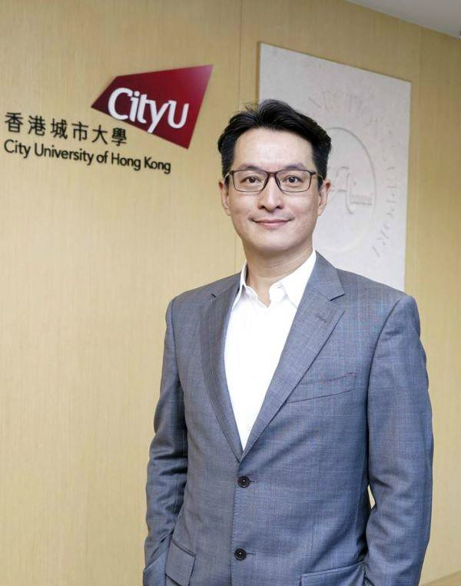
Contact
Email: peter_cheng@hanbo.com
Management Trainee Info
Anson – anson.chin@fufalabs.com
Andy - andy.yang@fufalabs.com
Thank you!

