Slide 1
Factors that shape/influence trade policy in Sri Lanka

Slide 2
Twin Deficits
Domestic industry
Public Sentiments
Key factors

Slide 3
Sri Lanka has one of the lowest Tax Revenue to GDP ratios in the world
Source: www. publicfinance.lk

Slide 4
Sri Lanka’s Fiscal Indicators weaker relative to regional peers
Source: www. publicfinance.lk

Slide 5
Sri Lanka’s Government Revenue heavily dependent on imports
Source: www. publicfinance.lk

Slide 6
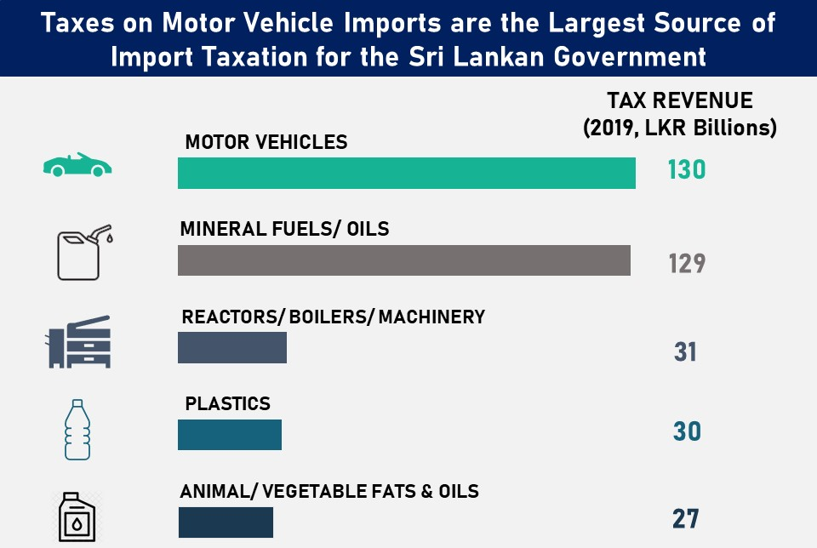
Sri Lanka’s Government Revenue heavily dependent on imports
Source: www. publicfinance.lk

Slide 7
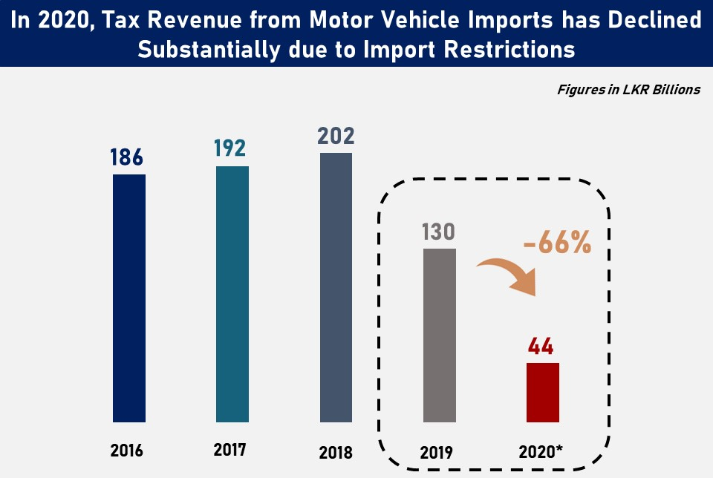
Sri Lanka’s Government Revenue heavily dependent on imports
Source: www. publicfinance.lk

Slide 8
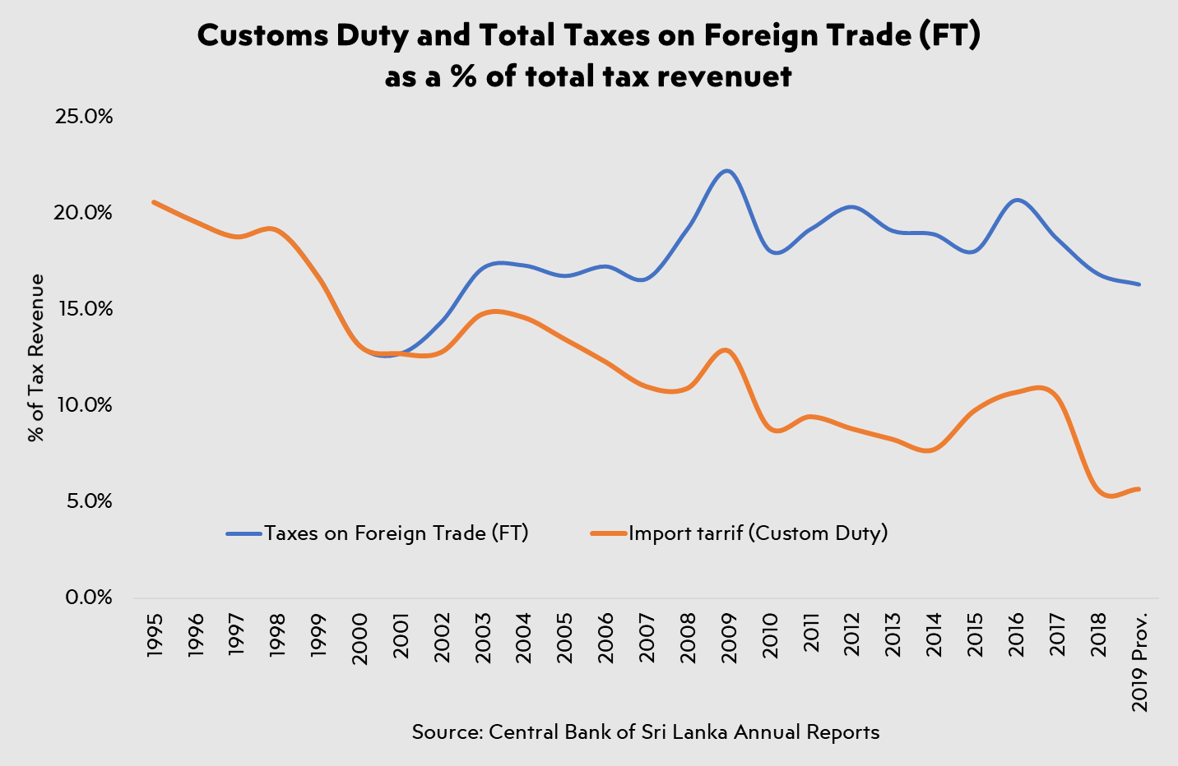
Para-tariffs: an attempt to protect domestic industry or recover lost revenue?

