Slide 1
POTENTIAL AND RISK OF
BELT AND ROAD IN CAMBODIA
KY SEREYVATH
Director General, Professor
INSTITUTE OF CHINA STUDIES,
ROYAL ACADEMY OF CAMBODIA
February 08th, 2021

Slide 2
Content
What is Potentials?
What is Risk?
What is Conclusion?

Slide 3
TOURISM
Tourist by Countries
China 32.6%
Vietnam 13.0%
Laos 7.9%
Thailand 6.2%
USA 5.2%
Korea Rep. 4.9%
Japan 3.4%
2018 Chinese tourist: 2.025 M
China Ready Policy to received 5 M tourist from China in 2025

Slide 4
CAMBODIA-CHINA TRADE
Import growth =15.49%
Export growth =27.18%

Slide 5
FDI (2018) in Million USD
 | Agricul | Mine | Factory | Finance | Hotel&Restau | ICT | Real Estate | Others | Total
China Mainland | 53 | 15 | 163 | 83 | 62 | 10 | 75 | 50 | 511
Hong Kong | 10 | 2 | 43 | 16 | 31 | 0 | 61 | 74 | 237
Taiwan | 0 | 0 | 45 | 33 | 0 | 0 | 19 | 8 | 105
Total | 63 | 17 | 251 | 132 | 93 | 10 | 155 | 132 | 853
Percentage | 27.16% | 89.47% | 64.36% | 24.49% | 40.79% | 66.67% | 41.89% | 47.48% | 39.58%
 | Agri. | Mine | Factory | Finance | Hotel & Rest. | ICT | Real Estate | Others | Total 2017 | Total 2016
China Mainland | 65.74 | 2.70 | 148.61 | 162.71 | 66.87 | 10.01 | 83.23 | 94.90 | 634.77 | 511
Hong Kong | 17.25 | 10.5 | 47.72 | 16.55 | 30.94 | 0 | 113.32 | 113.06 | 349.34 | 237
Taiwan | 0 | 0 | 24.22 | 106.68 | 0 | 0 | 27.08 | 10.73 | 168.71 | 105
Total | 82.99 | 13.2 | 220.55 | 285.94 | 97.81 | 10.01 | 223.63 | 218.69 | 1,152.82 | 853
Percentage of total by sector | 35.49% | 69.25% | 61.89% | 30.05% | 30.73% | 48.59% | 60.80% | 54.85% | 41.35% | 39.58%

Slide 6
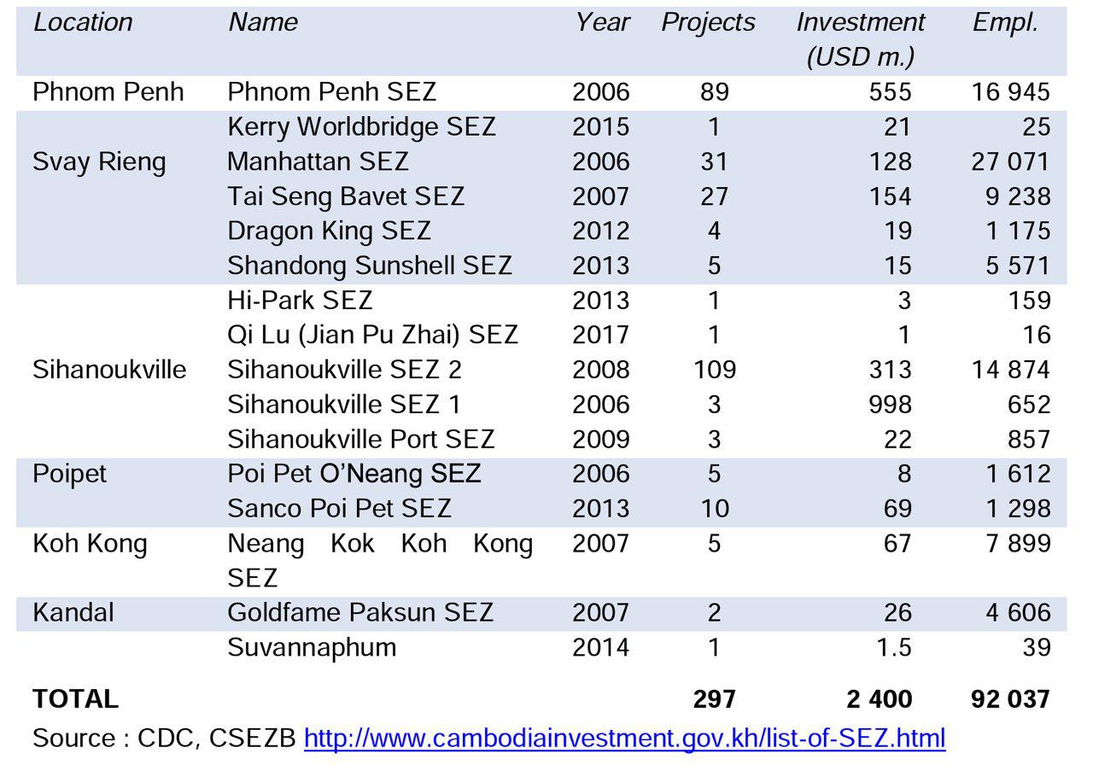
5 Chinese SEZs
123 projects
$1,349M

Slide 7
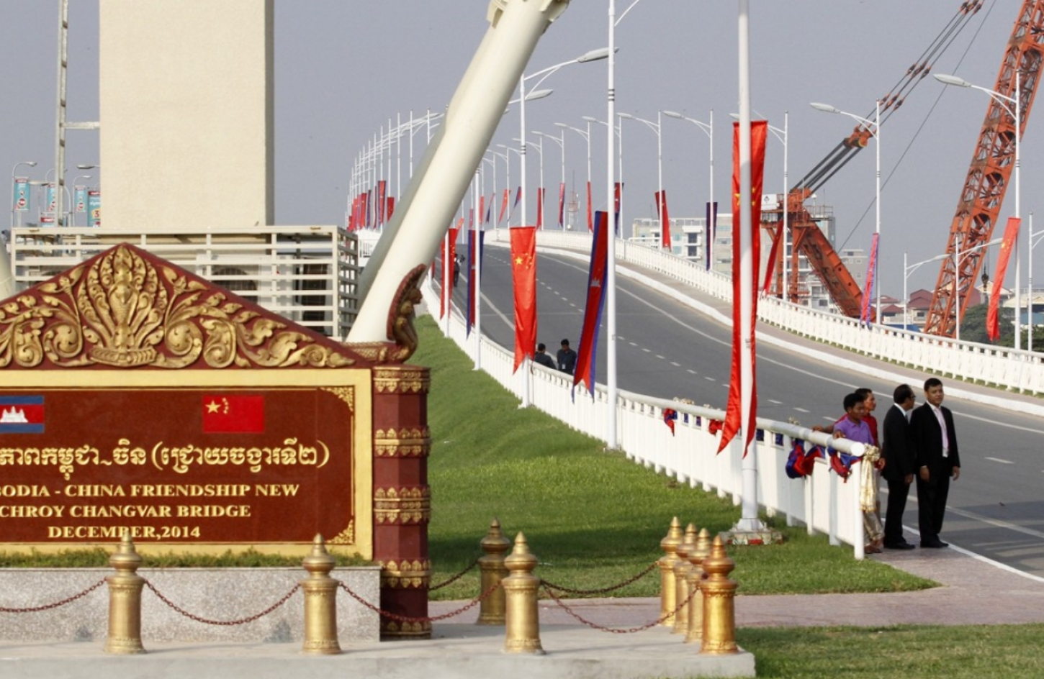
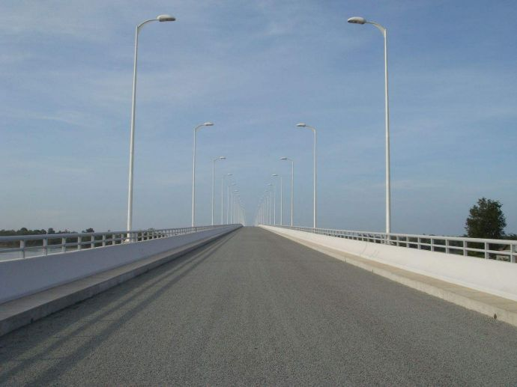
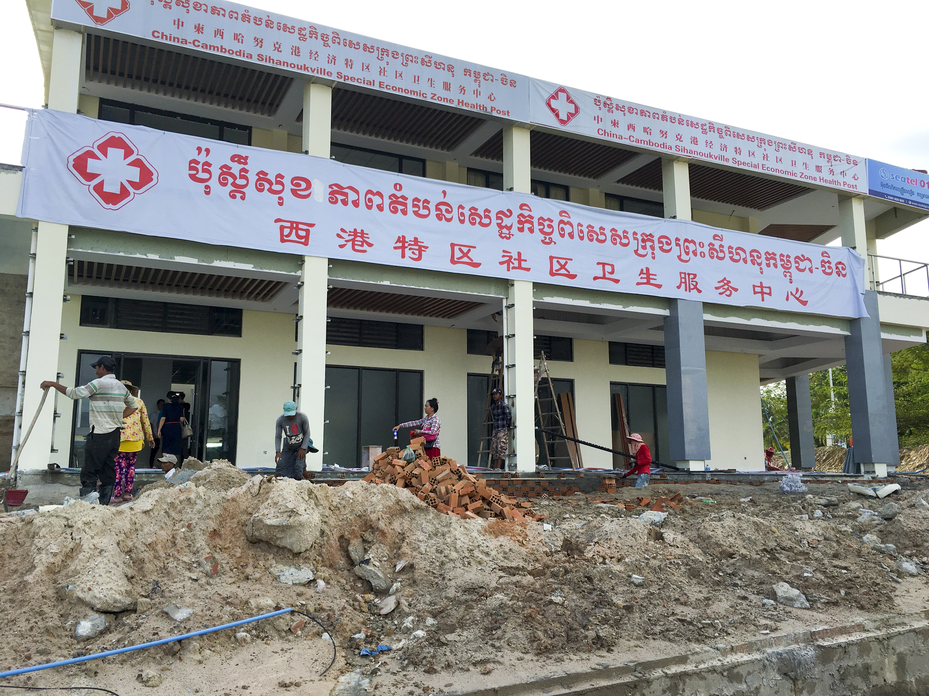
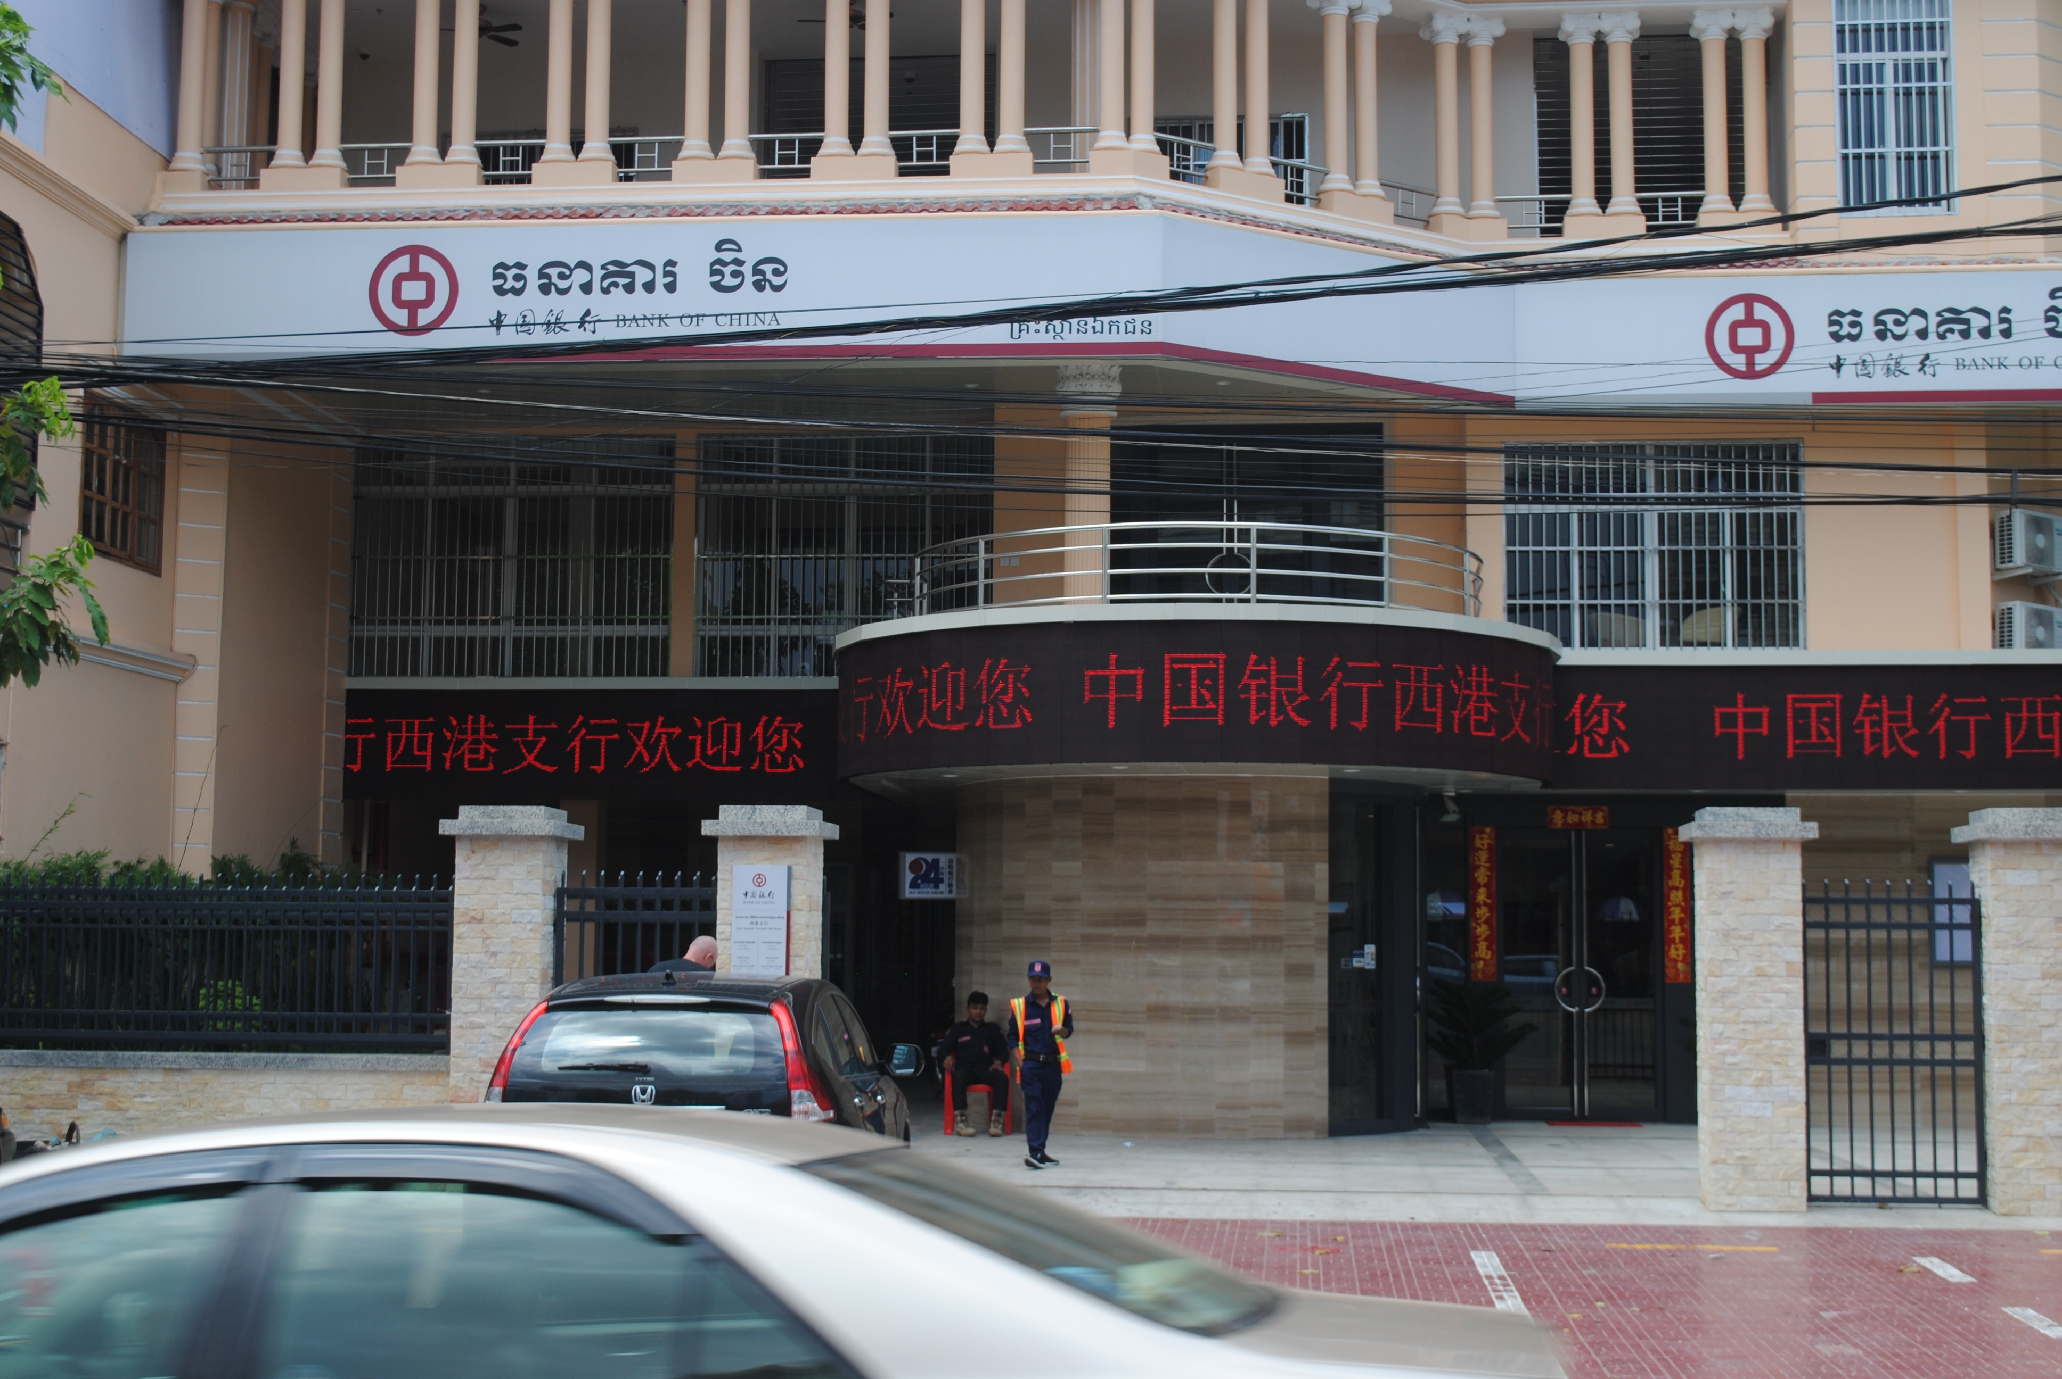
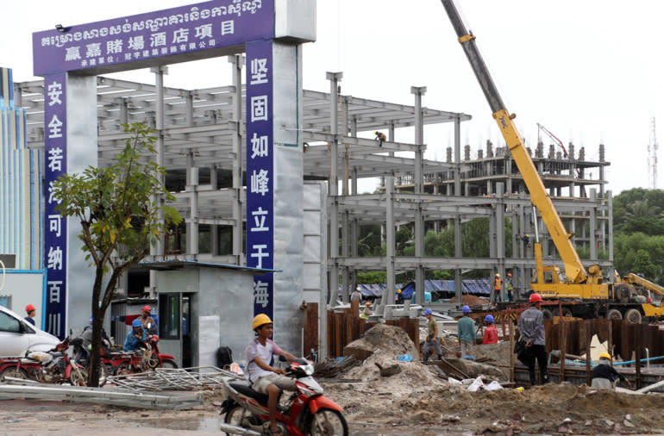

Slide 8
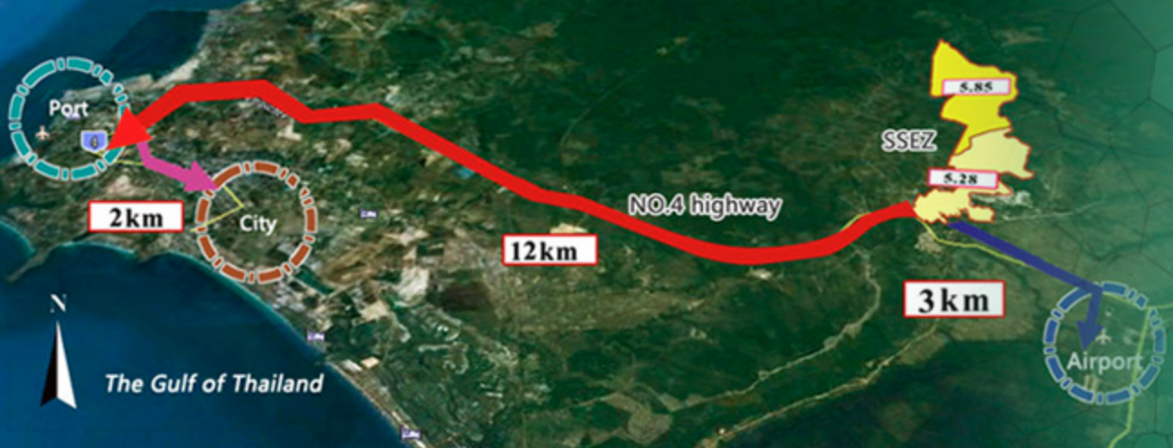
Sihanouk Special Economic Zone

Slide 9
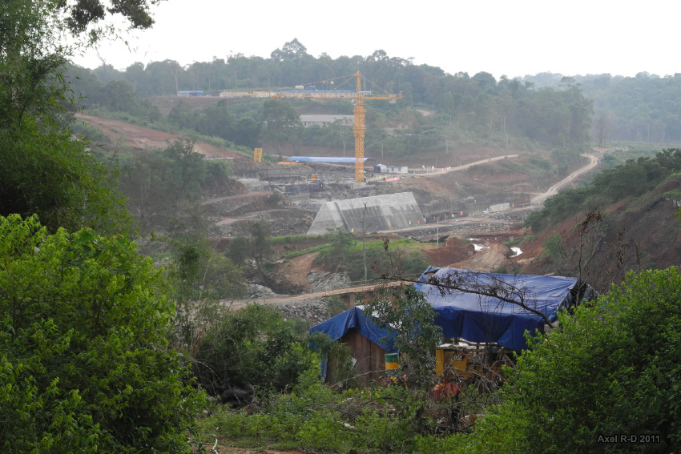
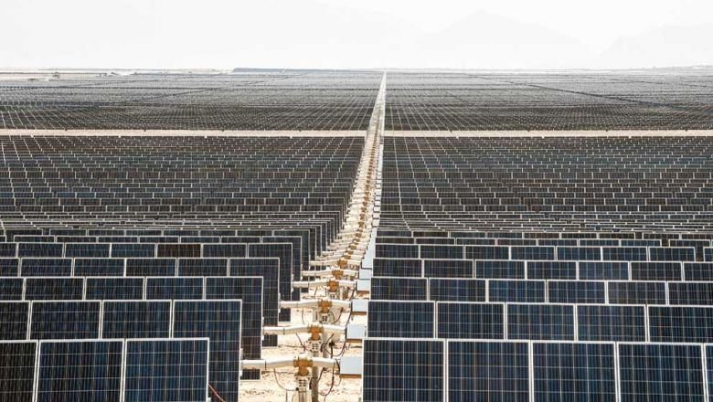
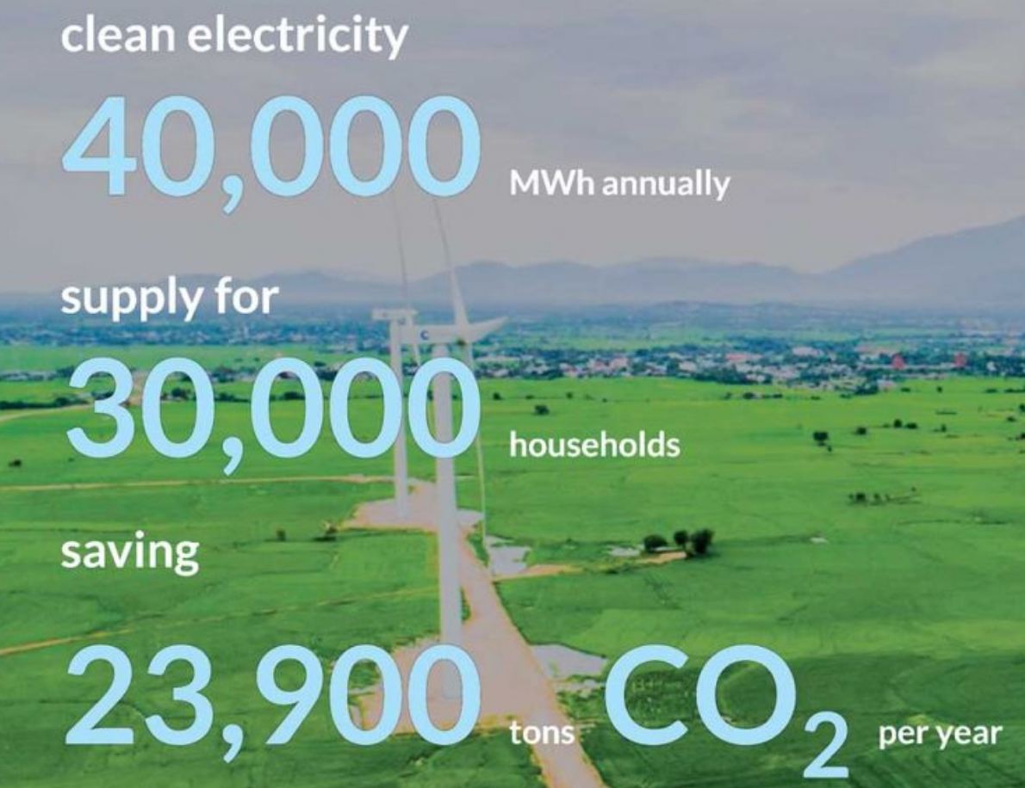
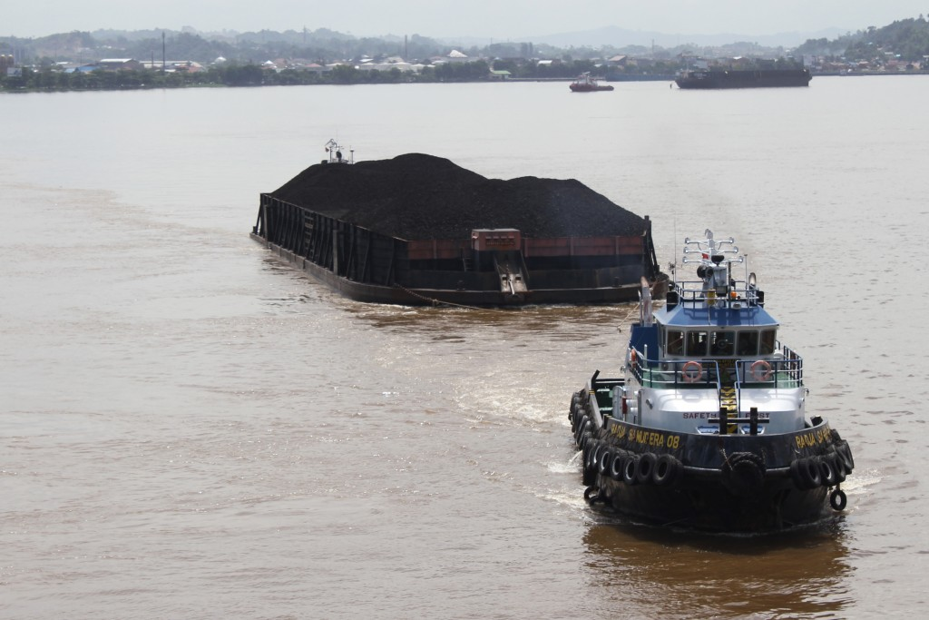
Energy
Hydropwer 7 plants: 1,327MW
Solar power: 60 MW in Kg Speu 2019
Wind power
Coal power

Slide 10
Bank Sector
2 Chinese Banks: Bank of China, and IBIC
Total Assets: $1,500 M = 8.3% of Total Bank Assets in Cambodia
Cambodia allowed Chinese RMB being used in the market as USD

Slide 11
Content
What is Potentials?
What is Risk?
\
What is Conclusion?

Slide 12
CAMBODIA-CHINA TRADE
Import growth =15.49%
Export growth =27.18%

Slide 13
TOURIST VISIT CAMBODIA

Slide 14
Risk
Termination of EBA
Tariff on rice export to EU
Hydropower
Social issues
Domestic price increase

Slide 15
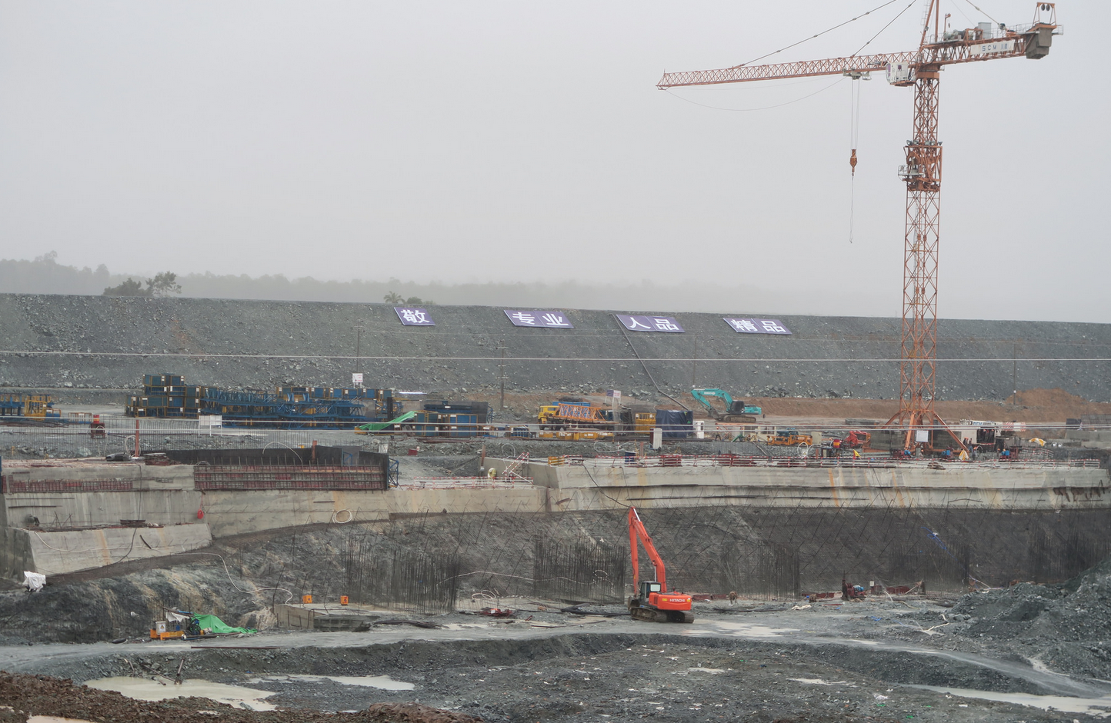

Slide 16
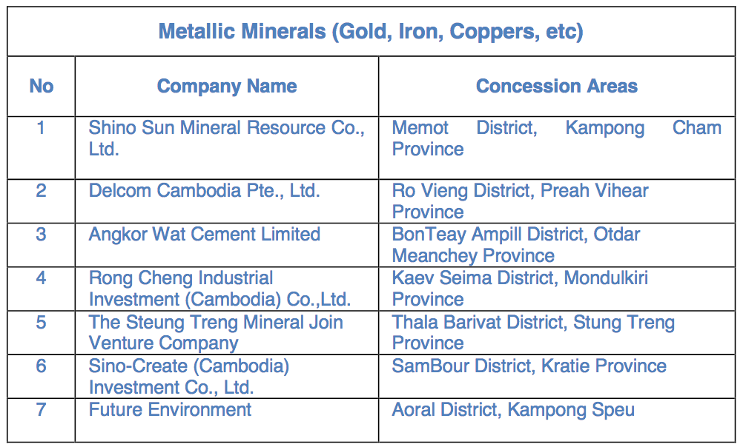
Mineral Exploration
Metallic mineral concessions: 62
Non-metallic exploration

Slide 17
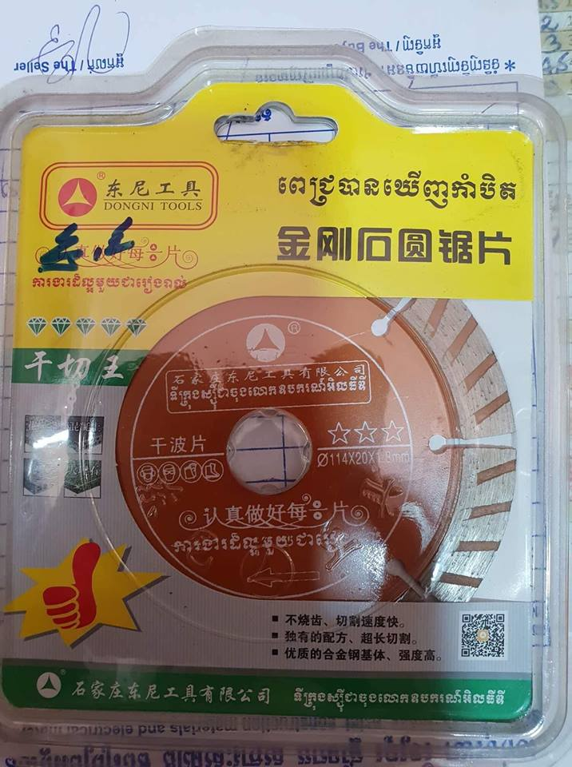
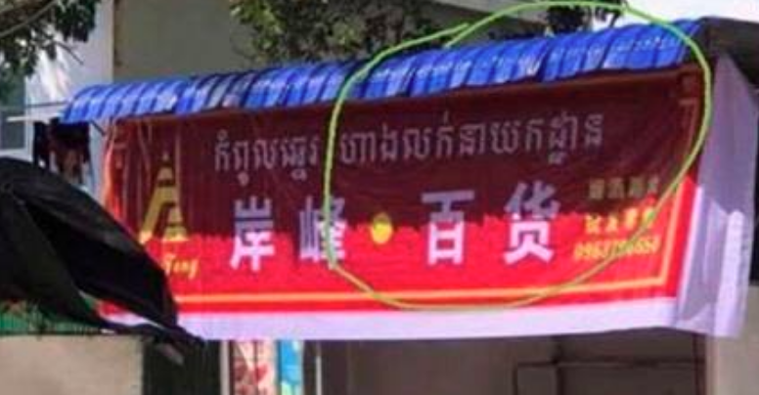

Slide 18
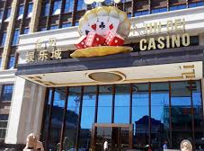
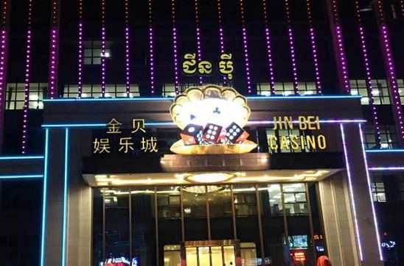
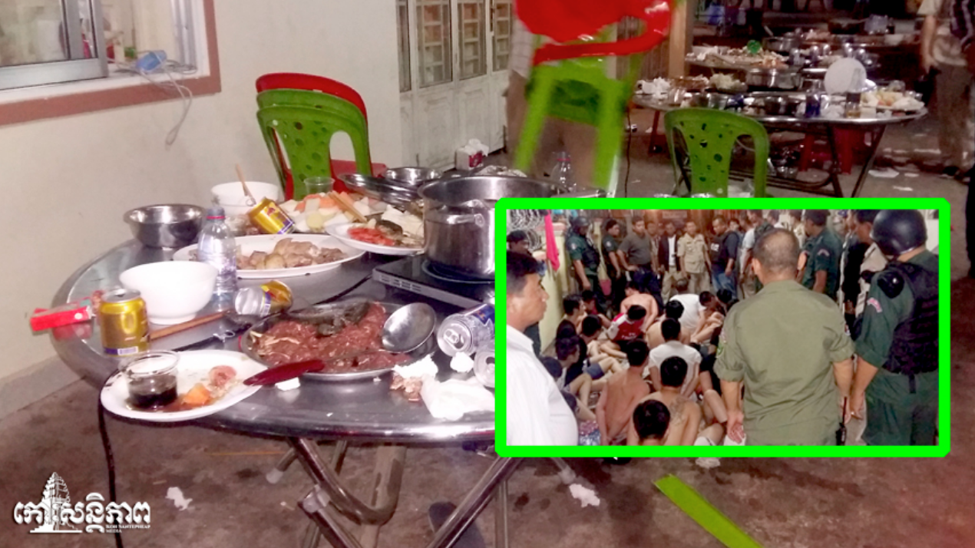

Slide 19
រាជបណ្ឌិត្យសភាកម្ពុជា
Royal Academy of Cambodia
Content
What is Potentials?
What is Risk?
What is Conclusion?

Slide 20
Conculsion
Potentials for Cambodia:
Big partners
Capital inflow for growth
Technology
Production and Tourism
Challenges:
Environment
Resources

Slide 21
Ways forward
Strengthen education
Rule of Law
Environmental protection
Renewable energy (Solar, Wind, Hydro)
Recycling waste technology
More cooperation on agricultural sector
Create an economic corridor

Slide 22
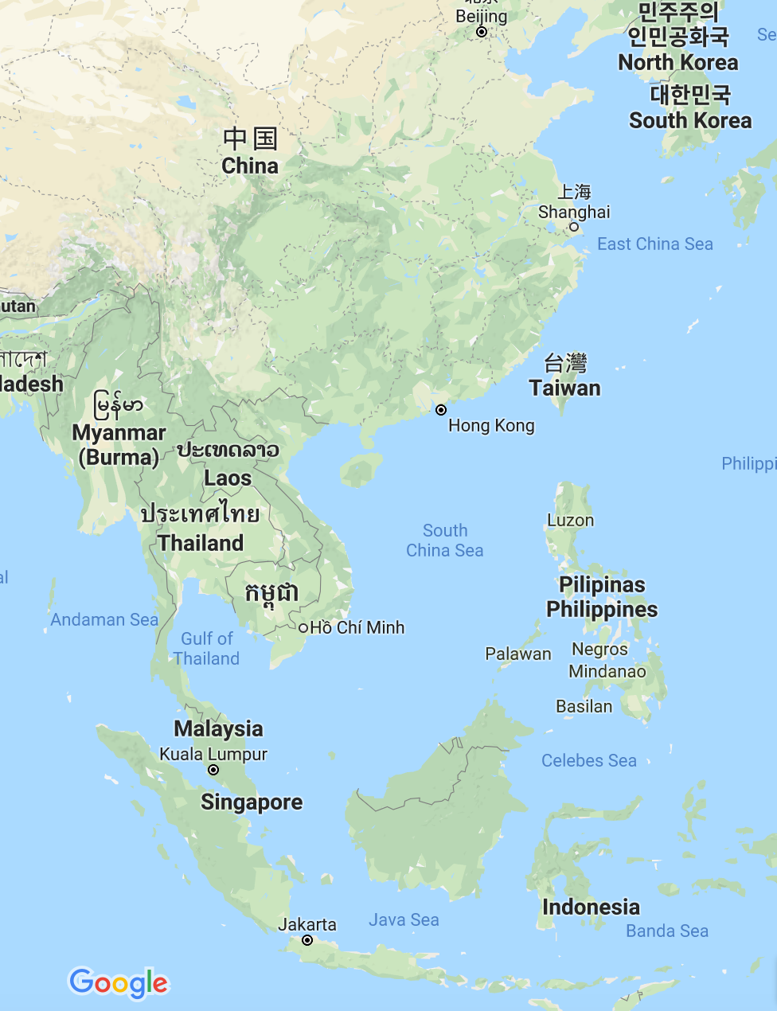
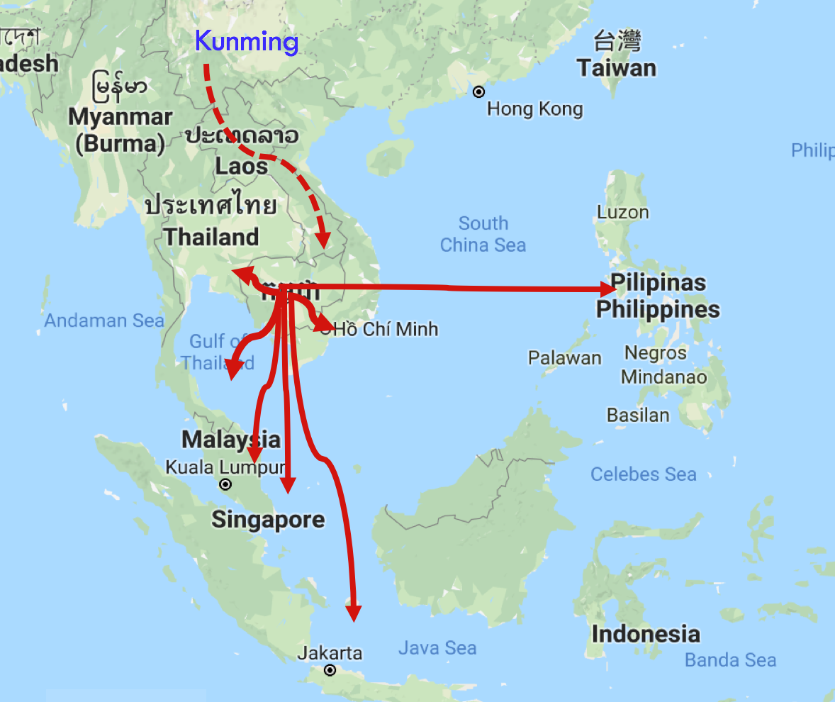
Kunming

Slide 23
THANK YOU

