Slide 2
Opportunities & Challenges in Overseas Projects
Introduction to the Group
Insights to Share
Opportunities & Risks

Slide 3
Introduction to the Group
Golden Resources Group
Established in 1946 (75 Years)
Started as Rice Trader – ASEAN Connections
Rice Milling Projects, PPP Projects, Property Development, Ports & Shipping Projects, Convenience Retail Network

Slide 4
Introduction to the Group
Vietnam
Master Franchise for Circle-K Convenience Stores
400 Stores – 5 Cities – 5,000 Staff

Slide 5
Insights to Share
Guest – Corporate Social Responsibilities (CSR)
Corporate Culture
Local Culture
Local Laws
Language / Communications

Slide 6
Insights to Share
Treat as Equals
Teaching
Opportunities
be Professional

Slide 7
Opportunities
ASEAN + Belt & Road
RCEP + CTPP
Infrastructure Investments – China Growth Model
Infrastructure > FDI > Manufacturing > Econ Growth
SOE > Private Enterprises > SME > Living Standard

Slide 8
Opportunities
Hong Kong’s Reindustrialization 4.0
Manufacturing / IP / Deisgn / Technology
Professional Scopes
Finance / Accounting / Legal
Regional Financial Hub / Corporate HQ / SPV Hub

Slide 9
Risks
Country Risks
Political Risks
Financial Flow Risk - Currency Risks
Material Flow Risk - Supply Chain Risks
Information Flow Risk – Accuracy / Disruption
Risk Mitigation Procedures

Slide 10
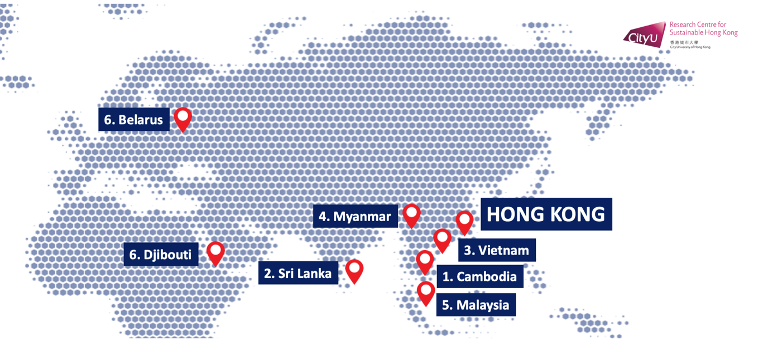
THANK YOU VERY MUCH

